Slide 1
Cosmos DB Vector Search – FuzzyWord
By: Vinoda Reddy
End-to-End System Using Azure OpenAI + Cosmos DB

Slide 2
What is Azure Cosmos DB?
A fully managed NoSQL database service from Microsoft Azure
Designed for global distribution, high availability, and low-latency performance
Supports multiple data models: JSON documents, key-value, graph, column-family
Automatically scales storage and throughput
Why Use Cosmos DB?
Very low latency (millisecond responses worldwide)
Fully serverless and auto-scalable
Schema-less JSON → easy to store flexible data
Globally distributed across multiple regions

Slide 3
CosmosDB Setup
Step 1: Create Cosmos DB Account
Go to Azure Portal → Create Resource → Select Azure Cosmos DB for NoSQL.
Step 2: Choose Database & API
Select the NoSQL API, region, and capacity mode.
Step 3: Create Database
Step 4: Create Container
Step 5: Get Connection String or IAM Policy
Copy the primary connection string from the Keys section for application use

Slide 4
VectorsDB & Use Cases
Vector Database
  Stores embeddings (numerical vectors that represent meaning)
  Enables fast similarity search using ANN algorithms
  Powers AI features like semantic search, chatbots, and recommendation engines
Semantic Search
  Searches by meaning, not keywords
  Example: Searching “cheap running shoes” also finds “budget sneakers”
AI Chatbots
  Converts user questions into embeddings
  Finds the closest matching answer from Vector DB
  Example: User asks “How to reset password?” → retrieves FAQ answer automatically

Slide 5
Embeddings
Embeddings are numerical vector representations of text (or images/audio) that capture the meaning and context of the input example: [0.12, -0.22, 0.98, ...]
• Converts text into numerical vectors
• Represents semantic meaning
• Similar meanings → closer vectors
• Used for search, clustering, recommendations

Slide 6
Vector Index & Clustering
A Vector Index is a specialized data structure that organizes high-dimensional embeddings so that similar vectors can be found quickly without scanning the entire database
Why it’s Needed
Embeddings are large (hundreds–thousands of numbers).
Searching through millions of vectors is slow.
Vector index makes similarity search fast, scalable, and efficient.
Some Techniques :
  DISKANN(Disk-Accelerated Approximate Nearest Neighbor):- A vector index designed to perform ANN search using SSD storage instead of RAM, allowing extremely large vector datasets to be searched efficiently.
  IVF (Inverted File Index):- This divides all embeddings into clusters (centroids) and searches only within the closest clusters, making similarity search faster.
  HNSW (Hierarchical Navigable Small World):- Uses a hierarchical graph structure to quickly find approximate nearest neighbors in large vector datasets.

Slide 7
Word Vector Example
king - man + woman = queen
Feature | King | Man | Queen | Woman | King − Man + Queen
Authority | 1 | 0.2 | 1 | 1 | 1−0.2+1=1.8
Gender | -1 | -1 | 1 | -1 | 1 − 1 + 1 =0
Hair/Bald | 0 | 1 | 1 | 0 | 0 − 1 + 0 = 0
Rich | 1 | 0.3 | 1 | 0.2 | 1−0.3+0.2 =0.9

Slide 8
Setup Vector DB in Cosmos DB
Step 1: Enable Vector Policy
Step 2: Create Container
Step 3: Define Vector Index
Step 4: Insert Items with Embeddings
Step 5: Run VectorDistance Queries

Slide 9
Azure OpenAI
• Azure OpenAI is a cloud service from Microsoft that gives you access to OpenAI’s powerful AI models—such as GPT, embeddings, and image models—inside the secure Azure environment .
  Generate text, chat responses, and summaries
  Create embeddings for vector search
  Build chatbots, copilots, and AI assistants
• Model: text-embedding-3-large:
  Converts text into a high-dimensional numerical vector
  Captures semantic meaning of words, sentences, or documents.
  These vectors are stored in Cosmos DB for ANN similarity search

Slide 10
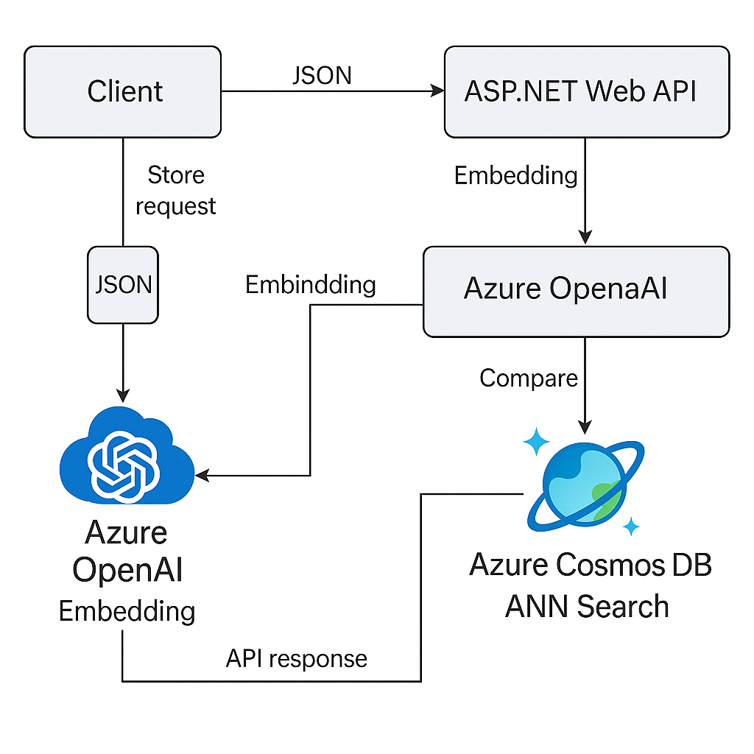
Architecture Diagram

